Slide 1
Secure Data Hiding in Image Using Steganography
CAPSTONE PROJECT
Presented By: Dhruv Subandh
Student Name: Dhruv Deepak Subandh
College Name: Modern Education Society’s Wadia College of Engineering,Pune-411001
Department: Electronics and Telecommunication

Slide 2
OUTLINE
Problem Statement
Technology used
Wow factor
End users
Result
Conclusion
Git-hub Link

Slide 3
Problem Statement
The project aims to develop a secure method for hiding sensitive data within digital images using steganography.
It addresses the need for confidential data transmission by embedding encrypted messages in image pixels without altering the visual quality.
The solution ensures data integrity, prevents unauthorized access, and enhances communication security.

Slide 4
Technology used
Steganography: The technique of hiding secret data within an image file.
The code hides a secret message in the pixel values of an image and retrieves it using the correct passcode.
Python: It is a high-level, versatile programming language known for its readability, simplicity, and wide range of applications, from web development to data science and automation.

Slide 5
LIBRARIES USED
OpenCV (cv2): For image processing (reading, modifying, and saving images).
OS (os): To interact with the operating system, such as opening the image file.
String (string): Although imported, it's not used in the current code.

Slide 6
Wow factors
Image-Based Steganography : Hides the secret message within the RGB pixel values of an image, making the data invisible to the naked eye
Simple Encryption Mechanism : Converts each character of the message to its ASCII value and embeds it into image pixels.
Password Protection : Adds a layer of security by requiring a passcode for successful decryption.
Lightweight and Efficient : Uses minimal libraries (OpenCV and os) for fast processing and easy portability.

Slide 7
End users
Cybersecurity Enthusiasts and Professionals
Students and Educators
Software Developers
Confidential Communication Users

Slide 8
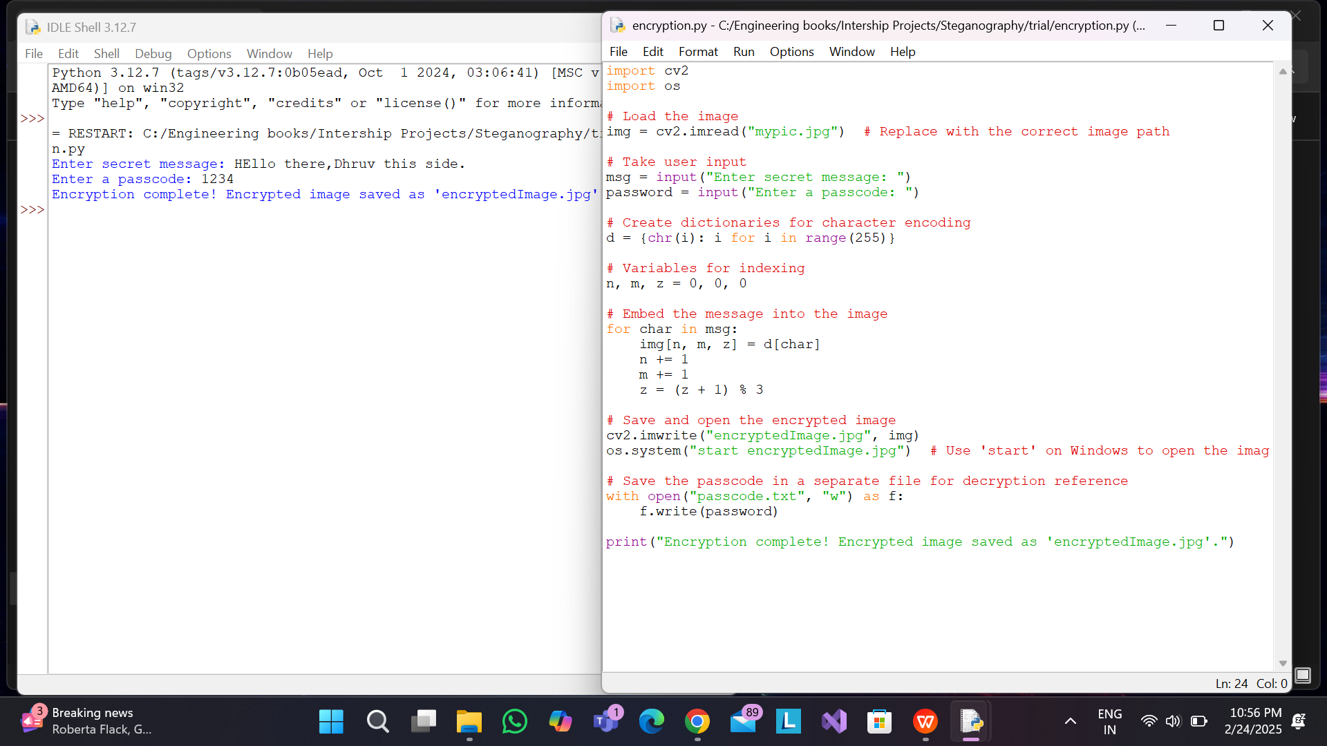
Results: Encryption

Slide 9

RESULTS: ENCRYPTED IMG

Slide 10
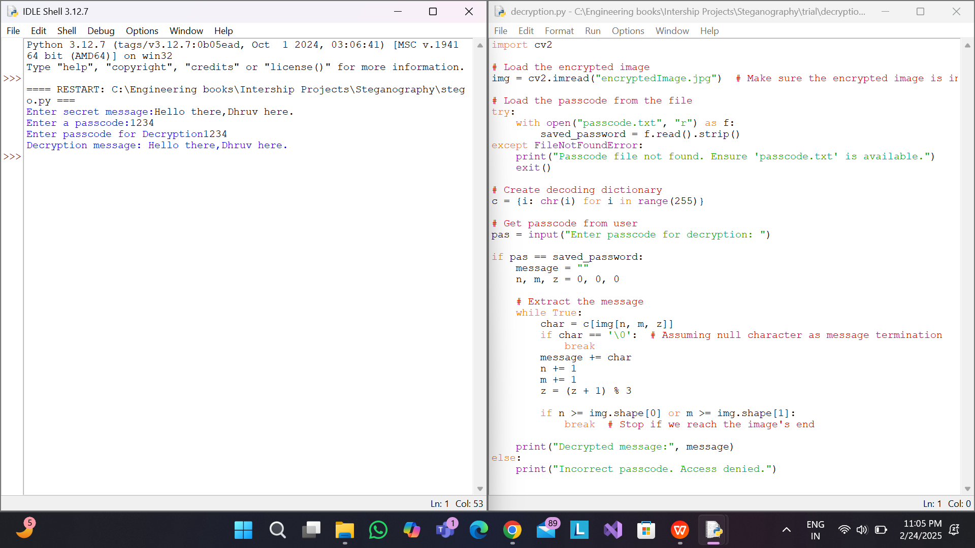
RESULTS: DECRYPTION

Slide 11
Conclusion
The primary objective of this project was to securely hide and retrieve secret messages within an image using steganography techniques combined with basic encryption and password protection. The developed Python-based solution successfully demonstrates how sensitive information can be embedded in the RGB pixel values of an image, making it invisible to the human eye and thus enhancing confidentiality.
By incorporating a password authentication mechanism, the project ensures that only authorized users can decrypt and access the hidden message, adding an essential layer of security. The use of OpenCV for image processing and the os module for file handling ensures efficient, lightweight, and platform-independent operation.

Slide 12
GitHub Link
https://github.com/DhruvSubandh26/IBM--Cybersecurity.git

Slide 13
THANK YOU

